Slide 1
HR Analytics Job change propensity for data scientists
07/26/2021
STA380: Introduction to Machine Learning
GROUP 3
Rushiil Deshmukh
Ramya Madhuri Desineedi
Jackson Hittner
Yashpreet Kaur
Kaushik Kumaran
Leyang Xu

Slide 2



BUSINESS CONTEXT
PROBLEM STATEMENT & IMPACT
1
Big Data and Data Science firm
Leyang
01
02
03
2
Offering Data Science training to candidates
BACKGROUND
STRATEGY
OBJECTIVE
Time and money investment for training new candidates
To plan the budget and course categorization to optimize training
To find which candidates could we provide a targeted training to?
3
Hiring data scientists from candidates who pass the training

Slide 3
Calculating Job Change propensity for Data Scientists
Leyang
1
A Data Science firm rolled out a technical training program
Calculate propensity of an applicant to join the firm
2
Wants to identify applicants (targets) who would join the firm after training
3
Focussed training (better quality, costlier) to be provided to the targets

Slide 4
Data Science Industry is seeing steep growth since 2020
28%
53%
64%
Rushiil
Increase in data science jobs
Increase in purchase of technology & infrastructure
Increase in training budget
Global Big Data Market CAGR: 10.9%
US $179.6 billion (2019) -> US $301.5 billion (2023)
Source: Analytics Insight

Slide 5
DATA DESCRIPTION
Enrollee_ID
Education level
Experience
Company size
Company type
Last new job
Training hours
Ramya
~19000 data points;
13 independent variables, binomial target variable
City
City_ development _index
Gender
Relevant experience
Enrolled university
Target: 0 – Not looking for job change, 1 – Looking for a job change (~25% of total population)
DATA CHALLENGES
PRE-PROCESSING
Missing values: ~ 32% of Company Type are blanks
Incorrect values: ‘10-49 seats’ in Company Size is being captured as date type instead of string
Missing values are imputed as 'Missing' for model to learn
Incorrect values are treated in excel before loading data
Grouping City data – Grouped less common city ids into “others” bucket based on their proportion in data (<2.5%)

Slide 6
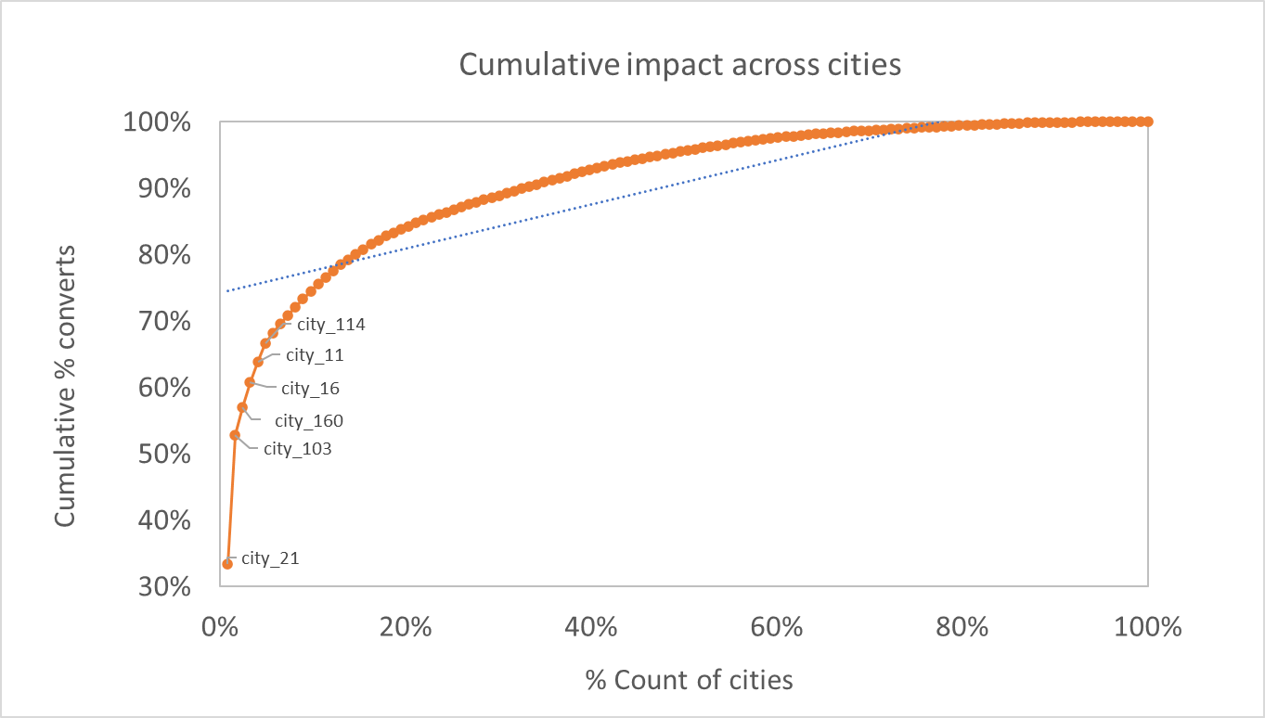
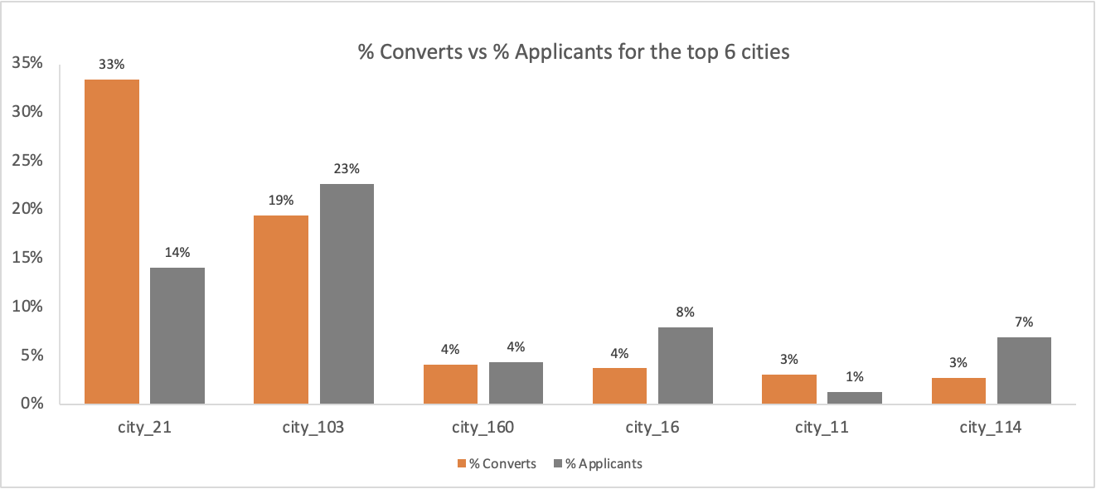
“City” and “Experience” are the most important variables in exploratory data analysis
Yashpreet
80% of targeted individuals come from 15% of total cities
% Targeted individuals are not in the same order as % Applicants from each city
For targets with lower experience, no relevant experience is acceptable
For targets with high experience, relevant experience is preferred

Slide 7
Parametric and Non-Parametric models were explored
Important Predictors
Key Model Features
City Development Index, City grouping
Company Type, company size
Education Level
Last New Job
Experience
Training Hours
Accuracy : 79.5%, Recall: 67.3%
Probability Threshold : 0.34
Encoded the categorical variables
The input features were scaled
Jackson / Kaushik
Logistic Regression
Random Forest
Important Predictors
Key Model Features
City Development Index, City grouping
Company Type, company size
Education Level
Last New Job
Experience
Major Discipline
Accuracy : 79.3%, Recall: 57.6%
Probability Threshold : 0.45
Cross Validation was used to test the accuracy (10-fold)
Gradient Boosting
Important Predictors
Key Model Features
City
Company Type, company size
Education Level
Last New Job
Experience
Accuracy : 80.3%, Recall: 63%
Probability Threshold : 0.45
Cross Validation was used to test the accuracy(10-fold)
Hyperparameter Tuning was performed to get the optimal combination of parameters (n-trees, shrinkage factor, interaction depth)
*Please refer Appendix – Modelling for confusion matrix and variable importance graphs

Slide 8
MODELLING IMPACT
Test sample size:
Normal training cost
(Without classification):
Targeted training cost
(With Classification):
Non-targeted training cost
(With Classification):
10,000
$400
$500
$300
Kaushik
Potential
Savings:
$500K
Actual
Savings:
$400K
*Please refer Appendix – Impact for detailed calculations

Slide 9
Thank you

Slide 10
appendix

Slide 11
APPENDIX - Modeling
GBM - Variable Importance with all independent variables
GBM - Variable Importance among most important independent variables
Jackson
Confusion Matrix. - GBM
Confusion Matrix. - Logistic Regression
Confusion Matrix. – Random Forest
 | Actual | Actuals
Prediction |  | 0 | 1
Prediction | 0 | 3080 | 456
 | 1 | 479 | 775
 | Actual | Actuals
Prediction |  | 0 | 1
Prediction | 0 | 2986 | 400
 | 1 | 582 | 822
 | Actual | Actuals
Prediction |  | 0 | 1
Prediction | 0 | 3112 | 521
 | 1 | 447 | 710

Slide 12

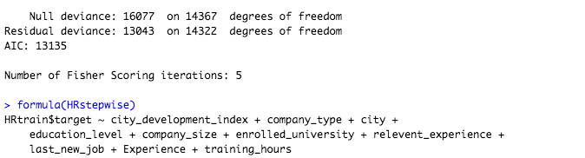

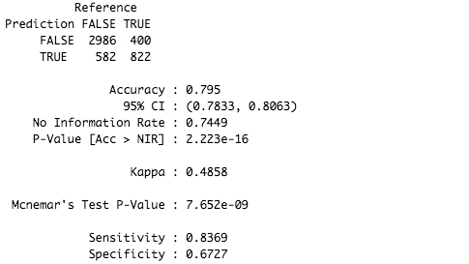

LOGISTIC REGRESSION
Full Model (All Variables)
Forward/Backward/Stepwise Selection
Null Model (No Variables)

Slide 13
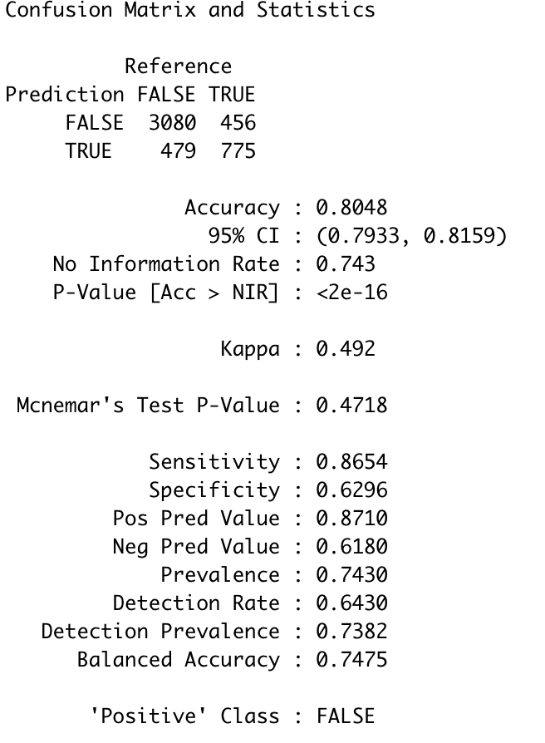
GBM

Slide 14
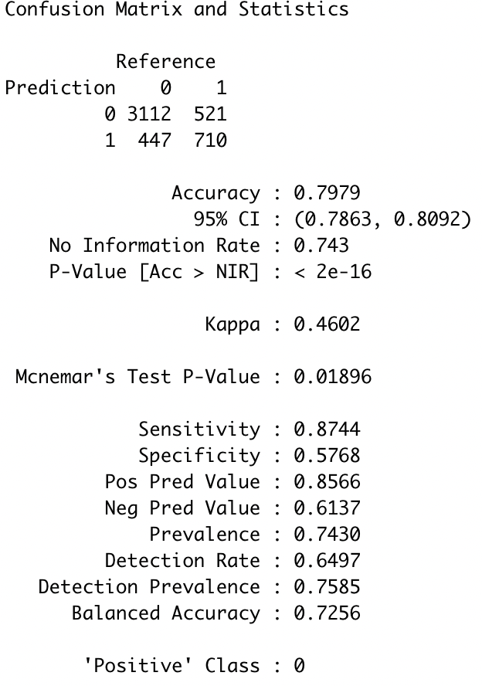
RANDOM FOREST

Slide 15
IMPACT
 | Annual
Total test sample | 10,000
 | Per person | 25%/ 75%
Expensive training cost for company | $500 | $ 1,250,000 | $ 1,496,625
Normal one | $300 | $ 2,250,000 | $ 2,693,925
 |  | $ 3,500,000 | $ 4,190,550
Average without clasfication | $400 | $ 4,000,000
 | Potential saving | $ 500,000
 | 80% | $ 400,000

